Slide 1
Learning
Learning
Inductive learning, Types of learning, supervised - decision trees classification, unsupervised learning :K-means clustering.
Unit - 5

Slide 2
Outline
General Concepts
Learning agents
Inductive learning
Types of learning
Supervised Learning
Decision trees classification
Unsupervised learning
K-means clustering.

Slide 3
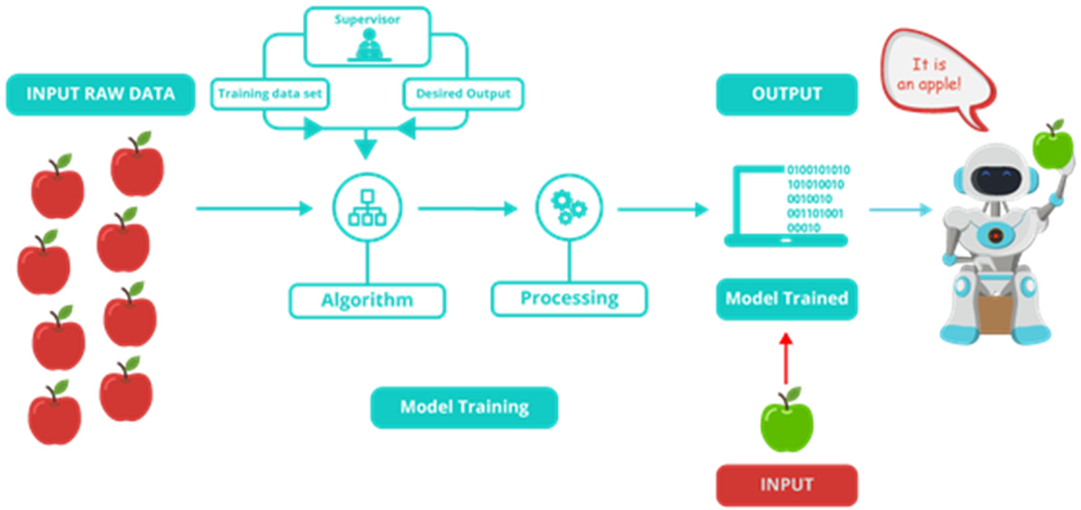
Example: - classification

Slide 4
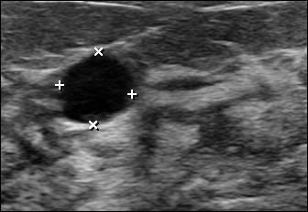
Example: clustering
Formation of clusters using VQ based algorithms
Ultrasound Image
. . .
C1
C2
C3
C4
C5
C6
C7
C8
Training set

Slide 5








Clusters converted to images
Cluster 1 Cluster 2 Cluster 3 Cluster 4
Cluster 5 Cluster 6 Cluster 7 Cluster 8

Slide 6


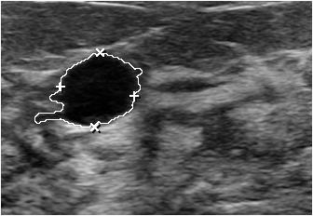
Final Result – validated cluster
Largest area consider as ROI
Other regions merged with the background
Original image
Extracted region
(First cluster)
Post processing
Final Result

Slide 7
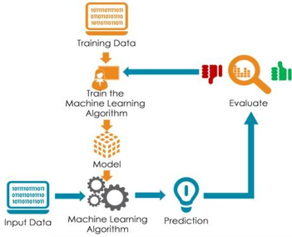
Learning Process

Slide 8
Learning (Machine Learning)
What is it ? Some Quotations
Herbert Simon, 1983
Learning denotes changes in a system that enable a system to do the same task more efficiently the next time.
Marvin Minsky, 1986
Learning is making useful changes in the workings of our minds.
Ryszard Michalski, 1986
Learning is constructing or modifying representations of what is being experienced.

Slide 9
What is learning ?
Learning is an important feature of “Intelligence”.
1.1 Definition
A computer program is said to learn from experience E with respect to some class of tasks T and performance measure P, if its performance at tasks in T, as measured by P, improves with experience E. (Mitchell 1997)
This means :

Slide 10
Given : a task T
A performance measure P
Some experience E with the task
Goal : Generalize the experience in a way that allows to improve your performance on the task.
Why do Machine Learning?
Understand and improve efficiency of human learning.
Discover new things or structure that is unknown to humans.
Fill in skeletal or incomplete specifications about a domain.

Slide 11
Learning
Learning is essential for unknown environments,
i.e., when designer lacks knowledge
Learning is useful as a system construction method,
i.e., expose the agent to reality rather than trying to write it down
Learning modifies the agent's decision mechanisms to improve performance

Slide 12
Learning Agent
Learning agent consist of four main components :
Learning element, Performance element, Critic, and Problem generator.

Slide 13
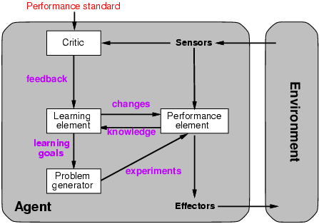
Learning agents

Slide 14
Components
■ Performance Element: It is the agent itself that acts in the world. It chooses the actions.
■ Learning Element: It is the part of the agent responsible for improving its performance.
■ Critic: Tells the Learning Element how agent is doing (success or failure) by comparing with a fixed standard of performance.
■ Problem Generator: Suggests "problems" or actions that will generate new examples or experiences that will aid in training the system further.

Slide 15
Example : Automated Taxi on city roads
■ Performance Element: Consists of knowledge and procedures for driving actions.
e.g., turning, accelerating, braking are performance element on roads.
■ Learning Element: Formulates goals.
e.g., learn rules for braking and accelerating, learn geography of the city, etc.
■ Critic: Observes world and passes information to learning element.
e.g. quick right turn across three lanes of traffic, observe reaction of other drivers.
■ Problem Generator: Try South city Road.

Slide 16
Learning element
Design of a learning element is affected by
Which components of the performance element are to be learned
What feedback is available to learn these components
What representation is used for the components
Type of feedback:
Supervised learning: correct answers for each example
Unsupervised learning: correct answers not given
Reinforcement learning: occasional rewards

Slide 17
Inductive learning
The inductive learning is a process of learning by example. The system tries to induce a general rules from a set of observed instances. The learning methods extract rules and patterns out of massive data sets.
The learning processes belong to supervised learning, does classification and constructs class definitions, called induction or concept learning.

Slide 18
Inductive learning
Simplest form: learn a function from examples
f is the target function
An example is a pair (x, f(x))
Problem: find a hypothesis h
such that h ≈ f
given a training set of examples
(This is a highly simplified model of real learning:
Ignores prior knowledge
Assumes examples are given

Slide 19
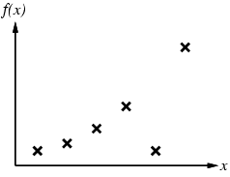
Inductive learning method
Construct/adjust h to agree with f on training set
(h is consistent if it agrees with f on all examples)
E.g., curve fitting:

Slide 20
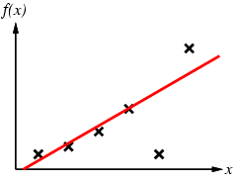
Inductive learning method
Construct/adjust h to agree with f on training set
(h is consistent if it agrees with f on all examples)
E.g., curve fitting:

Slide 21
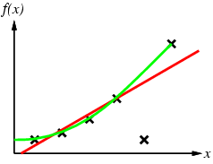
Inductive learning method
Construct/adjust h to agree with f on training set
(h is consistent if it agrees with f on all examples)
E.g., curve fitting:

Slide 22
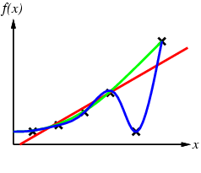
Inductive learning method
Construct/adjust h to agree with f on training set
(h is consistent if it agrees with f on all examples)
E.g., curve fitting:

Slide 23
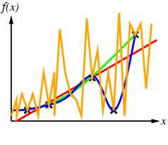
Inductive learning method
Construct/adjust h to agree with f on training set
(h is consistent if it agrees with f on all examples)
E.g., curve fitting:

Slide 24
Inductive learning method
Construct/adjust h to agree with f on training set
(h is consistent if it agrees with f on all examples)
E.g., curve fitting:
Ockham’s razor: prefer the simplest hypothesis consistent with data

Slide 25
Decision trees
Decision tree is a classifier in the form of a tree structure where each node is either a leaf or decision node.
leaf node - indicates value of the target attribute (class) of examples.
decision node – specify test to be carried on an attribute-value.
■ Decision trees learn knowledge on classification. The conditions are:
Attribute-value description: Same attributes must describe each example and have a fixed number of values.

Slide 26
Contd…
Predefined classes : The categories to which examples are to be assigned must already be defined.
Discrete classes: Classes must be sharply delineated. Continuous classes broken up into unambiguous categories such "hard", "flexible", "soft".
Sufficient data: Enough training (test) cases to distinguish valid patterns.
Decision tree programs construct a decision tree T from a set of training cases. The advantage of a decision tree learning is that a program, rather than a knowledge engineer, elicits knowledge from an expert.

Slide 27
Learning - decision trees
Problem: decide whether to wait for a table at a restaurant, based on the following attributes:
Alternate: is there an alternative restaurant nearby?
Bar: is there a comfortable bar area to wait in?
Fri/Sat: is today Friday or Saturday?
Hungry: are we hungry?
Patrons: number of people in the restaurant (None, Some, Full)
Price: price range ($, $$, $$$)
Raining: is it raining outside?
Reservation: have we made a reservation?
Type: kind of restaurant (French, Italian, Thai, Burger)
WaitEstimate: estimated waiting time (0-10, 10-30, 30-60, >60)

Slide 28
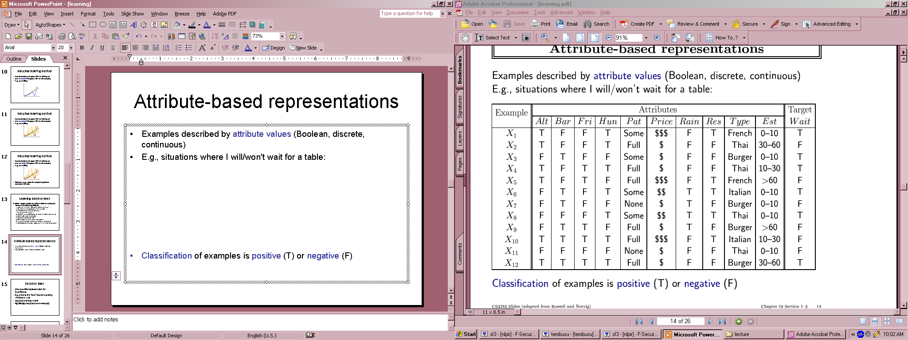
Attribute-based representations
Examples described by attribute values (Boolean, discrete, continuous)
E.g., situations where I will/won't wait for a table:
Classification of examples is positive (T) or negative (F)

Slide 29
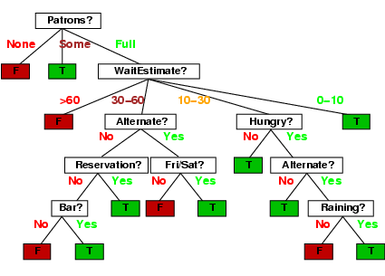
Decision trees
One possible representation for hypotheses
E.g., here is the “true” tree for deciding whether to wait:
Decision Tree
Training Set

Slide 30
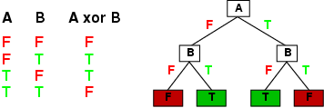
Expressiveness
Decision trees can express any function of the input attributes.
E.g., for Boolean functions, truth table row → path to leaf:
Trivially, there is a consistent decision tree for any training set with one path to leaf for each example (unless f nondeterministic in x)
but it probably won't generalize to new examples
Prefer to find more compact decision trees

Slide 31
Some specific applications include
◊ medical diagnosis,
◊ credit risk assessment of loan applications,
◊ equipment malfunctions by their cause,
◊ classification of plant diseases, and
◊ web search classification.

Slide 32
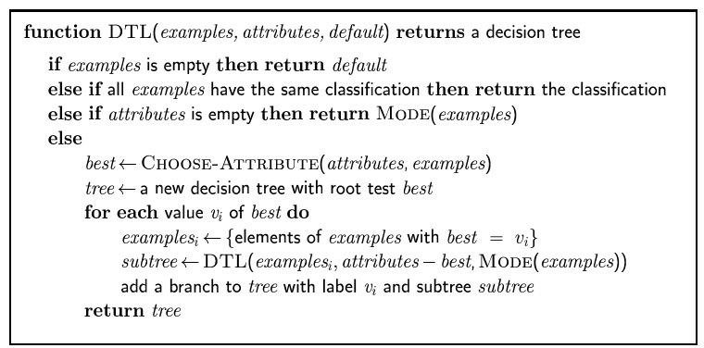
Decision tree learning
Aim: find a small tree consistent with the training examples
Idea: (recursively) choose "most significant" attribute as root of (sub)tree

Slide 33
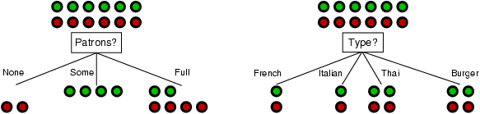
Choosing an attribute
Idea: a good attribute splits the examples into subsets that are (ideally) "all positive" or "all negative"
Patrons? is a better choice

Slide 34
Using information theory
To implement Choose-Attribute in the DTL algorithm
Information Content (Entropy):
I(P(v₁), … , P(v_{n})) = Σ_{i=1} -P(v_{i}) log₂ P(v_{i})
For a training set containing p positive examples and n negative examples:

Slide 35
Information gain
A chosen attribute A divides the training set E into subsets E₁, … , E_{v} according to their values for A, where A has v distinct values.
Information Gain (IG) or reduction in entropy from the attribute test:
Choose the attribute with the largest IG

Slide 36
Information gain
For the training set, p = n = 6, I(6/12, 6/12) = 1 bit
Consider the attributes Patrons and Type (and others too):
Patrons has the highest IG of all attributes and so is chosen by the DTL algorithm as the root

Slide 37
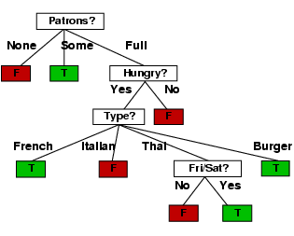
Example contd.
Decision tree learned from the 12 examples:
Substantially simpler than “true” tree---a more complex hypothesis isn’t justified by small amount of data

Slide 38
Summary
Learning needed for unknown environments, lazy designers
Learning agent = performance element + learning element
For supervised learning, the aim is to find a simple hypothesis approximately consistent with training examples
Decision tree learning using information gain
Learning performance = prediction accuracy measured on test set

Slide 39
Explanation Based Learning (EBL)
Human learning is accomplished by examining particular situations and relating them to background knowledge in the form of known general principles. This kind of learning, called "Explanation Based Learning (EBL)".
EBL provides a way of generalizing a machine-generated explanation of a situation into a rule which applies not only to the current situation but to similar ones as well.

Slide 40
The step by step approach is :
■ From an example, first construct an explanation, by applying a problem solver, to relate the example to some general domain theory.
■ The result is a "proof" or trace of the example with respect to the theory.
■ This is then generalized, by discarding irrelevant parts of it, into an explanation that applies to other examples too.
■ Finally, operational rules are extracted from the general explanation.

Slide 41
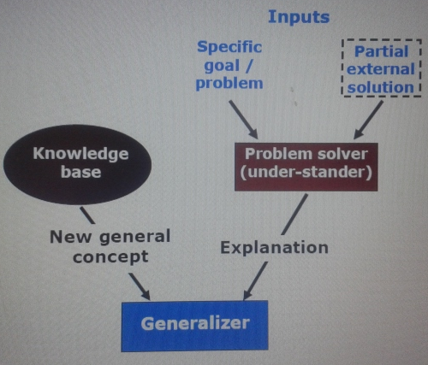
EBL architecture

Slide 42
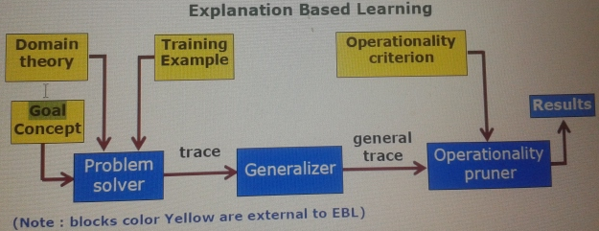
EBL System Schematic

Slide 43
Goal concept : A high level description of the concept to be learned; e.g., the definition of a cup in function-structure because it involves functional properties (lift able, stable, open-vessel . . .) rather than
structural features (light, part of, pointing . . .).
Training Example : An example which is a set of facts describing an instance of the goal concept
Domain theory : A set of facts describing an instance of the goal concept. It represents the facts and rules that constitute what the learner knows.

Slide 44
Contd…
The cup domain includes facts: concavities, bases, and lug, as well as rules: about lift ability, stability and what makes an open vessel.
Operational criterion: Specifies the form in which the generalized concept definition may be expressed

Slide 45
Unsupervised learning
Clustering is a way to form 'natural groupings' or clusters of patterns. Clustering is often called an unsupervised learning.

Slide 46
Contd…
■ Clustering is one of the most utilized data mining techniques.
■ The data have no target attribute. The data set is explored to find some intrinsic structures in them.
■ Unlike Classification where the task is to learn to assign instances to predefined classes, in Clustering no predefined classification is required. The task is to learn a classification from the data.

Slide 47
Reinforcement learning
Reinforcement learning refers to a class of problems in machine learning which postulate an agent exploring an environment in which the agent perceives its current state and takes actions.
The environment, in return, provides a reward (which can be positive or negative). Reinforcement learning algorithms attempt to find a policy for maximizing cumulative reward for the agent over the course of the problem.

Slide 48
Contd…
In other words Reinforcement learning is a computational approach to learning whereby an agent tries to maximize the total amount of reward it receives when interacting with a complex, uncertain environment."

Slide 49
Reinforcement Learning
Agent - Environment interaction
■ Reinforcement learning (RL) is a computational approach to, understanding and automating, goal-directed learning and decision making.
■ RL emphasis is on learning from interaction with its environment.
■ Reinforcement learning uses a formal framework defining the interaction between a learning agent and its environment in terms of states, actions, and rewards.

Slide 50
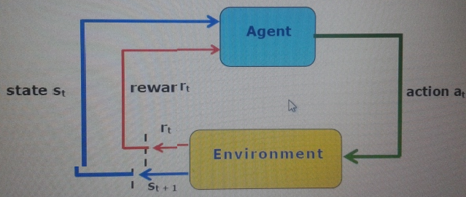
The state-action pairs form value functions that does efficient search in the space of policies guided by evaluations of all policies.

Slide 51
Agent - Environment interaction
The agent and environment interact at each sequence of discrete time steps, t = 0, 1, 2, 3, 4, -----
At each discrete time t, the agent (learning system) observes state st ∈ S and chooses action at ∈ A
Then agent receives an immediate numerical reward rt+1 ∈ ℜ and the state changes to st+1
At each time step, the agent implements a mapping from states to probabilities of selecting each possible action.

Slide 52
Contd…
This mapping is called the agent's policy and is denoted πt, where πt(s,a) is the probability that at = a if st ∈ S.
Reinforcement learning methods specify how the agent changes its policy as a result of its experience.
The agent's goal, is to maximize the total amount of reward it receives over the long run.

Slide 53
Key Features of RL
■ The learner is not told what actions to take, instead it finds out what to do by trial-and-error search
■ The environment is stochastic (ie behavior is non-deterministic means a state does not fully determine its next state).
■ The reward may be delayed, so the learner may need to sacrifice short-term gains for greater long-term gains.
■ The learner has to balance the need to explore its environment and the need to exploit its current knowledge.

